Slide 1

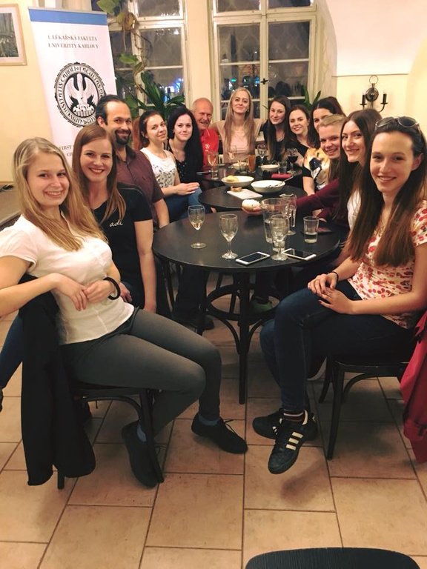
ICUDDR & ISSUP WEBINAR 15/6/2021
Forming a Student Professional Network
A Case Study Czech Republic
Anna Volfová
Department of Addictology, Charles University, Prague

Slide 2

How students can work together to form a professional network?

Slide 3
6
Developing and supporting a student network is worth it!
  You will always find a few students motivated to do big things!
  You will always find teachers to support good things!
Take-home messages
  A good example of a student network is in Czechia :)
  The quality of a program grows with the activity of students!
  The motivation to publish grows when social support via a student network works!

Slide 4
Czech
Association of
Addictology
Students

Slide 5



March 2015
A FEW ENTHUSIAST STUDENTS
Studying their second year bachelor´s degree
WHAT HAPPENED?
A SUPPORTING SUPERVISOR/TEACHER
With a vision, seeing the power of student networking, giving advice
ENERGY TO GO THROUGH THE FORMAL PROCESS
Registering the student network as a regular non-profit body with its legal subjectivity

Slide 6
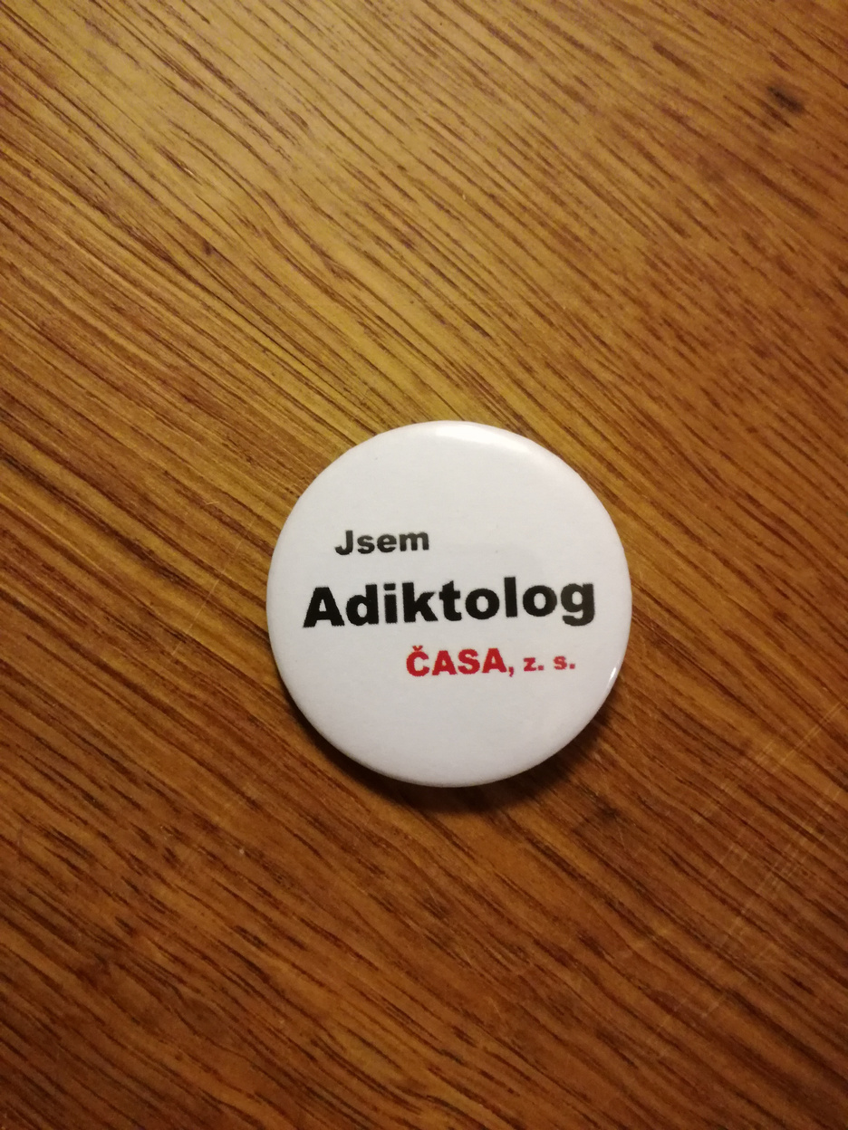
The main benefits identified
1
2
3
4
5
Strengthening competencies
Building relationships
Interdisciplinary cooperation
Quality improvement
Creating opportunities
organising hundreds of events and sessions, communication, leadership, cooperation
in the field, with classmates, other students, with the institution
together events, mutual learning, fullfilling the plurality principle, broadening knowledge, making a good basis for future work
study programs, teaching techniques
job opportunities, experience makers, conference contributions, mobility support

Slide 7
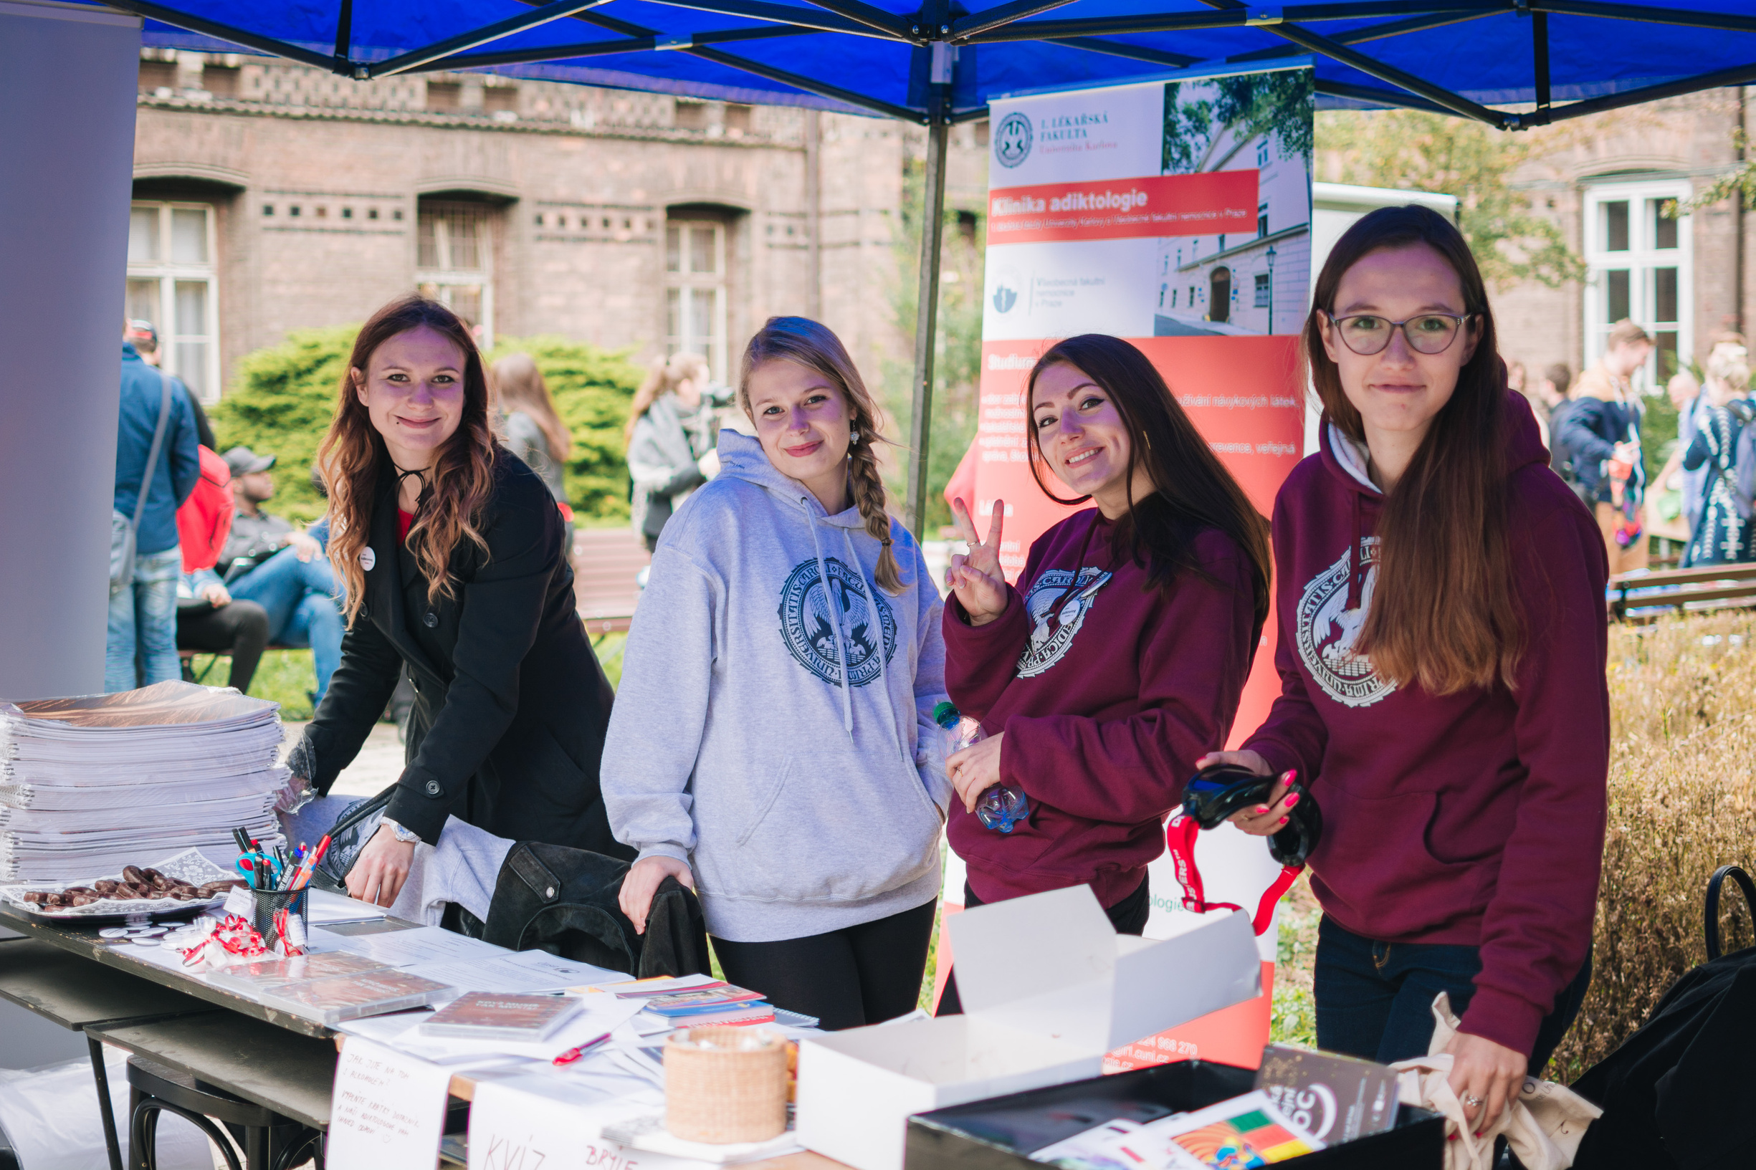
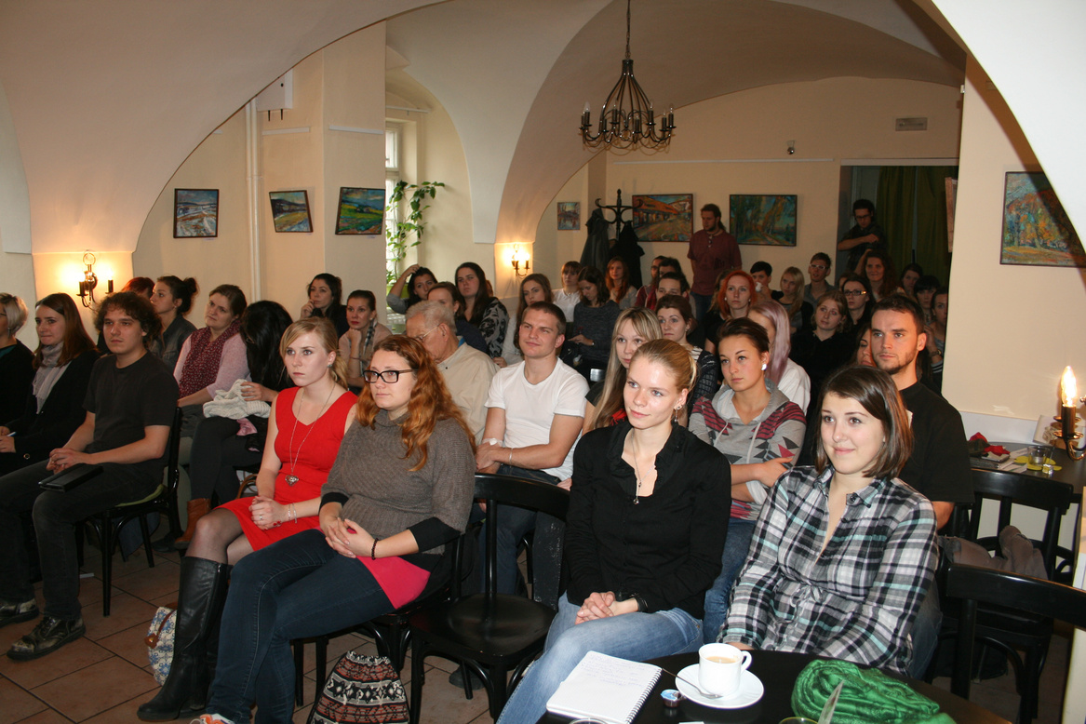
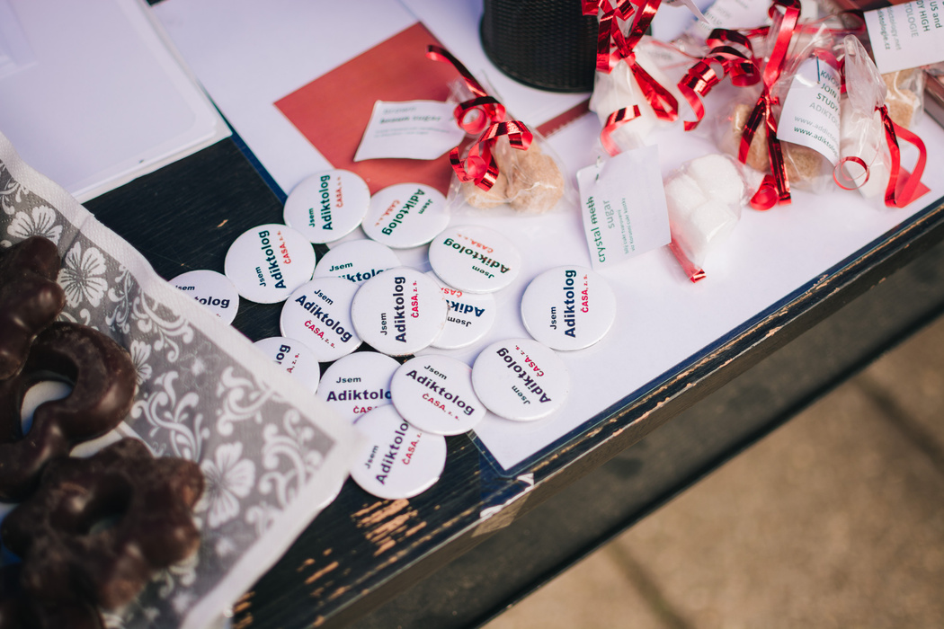
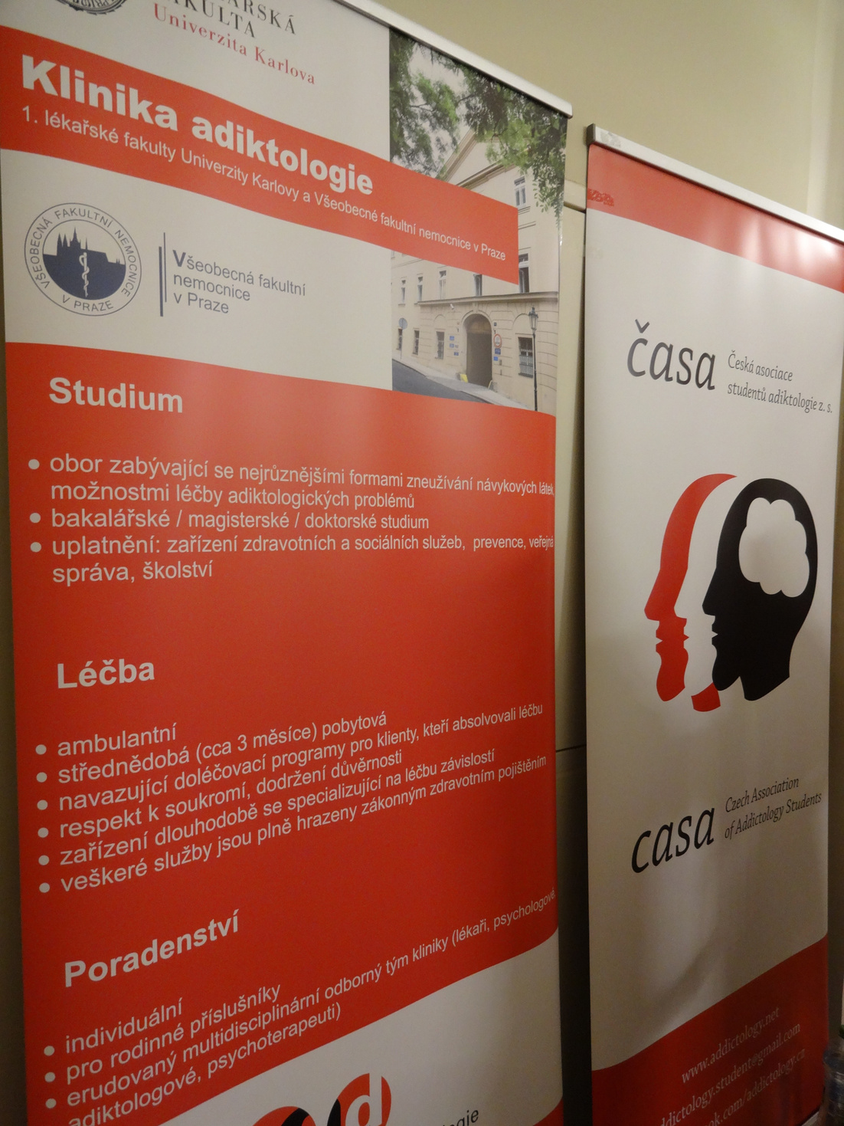
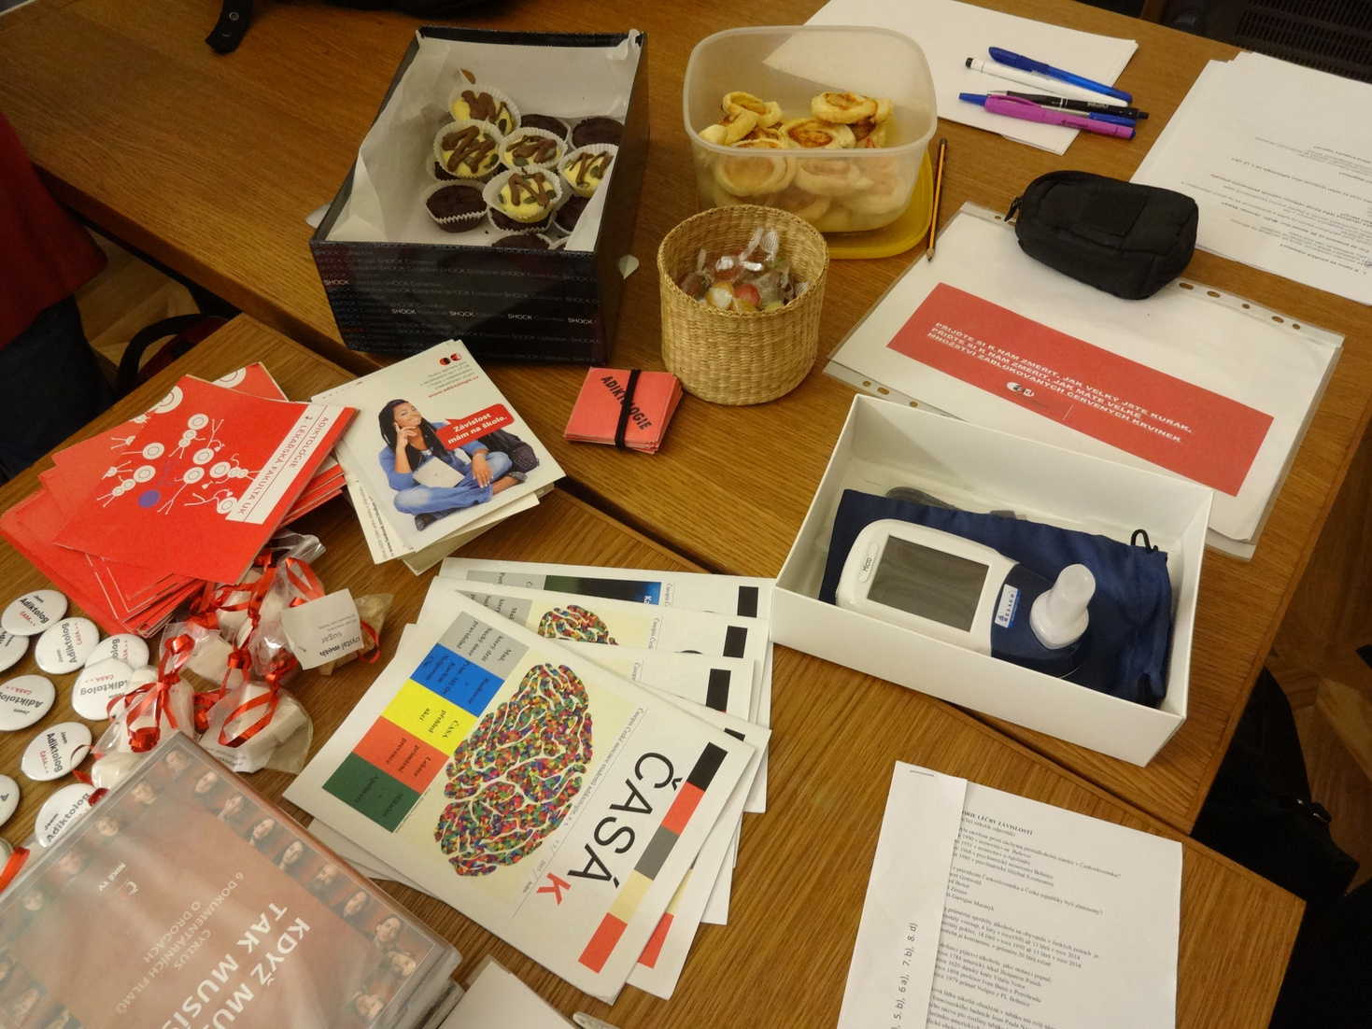
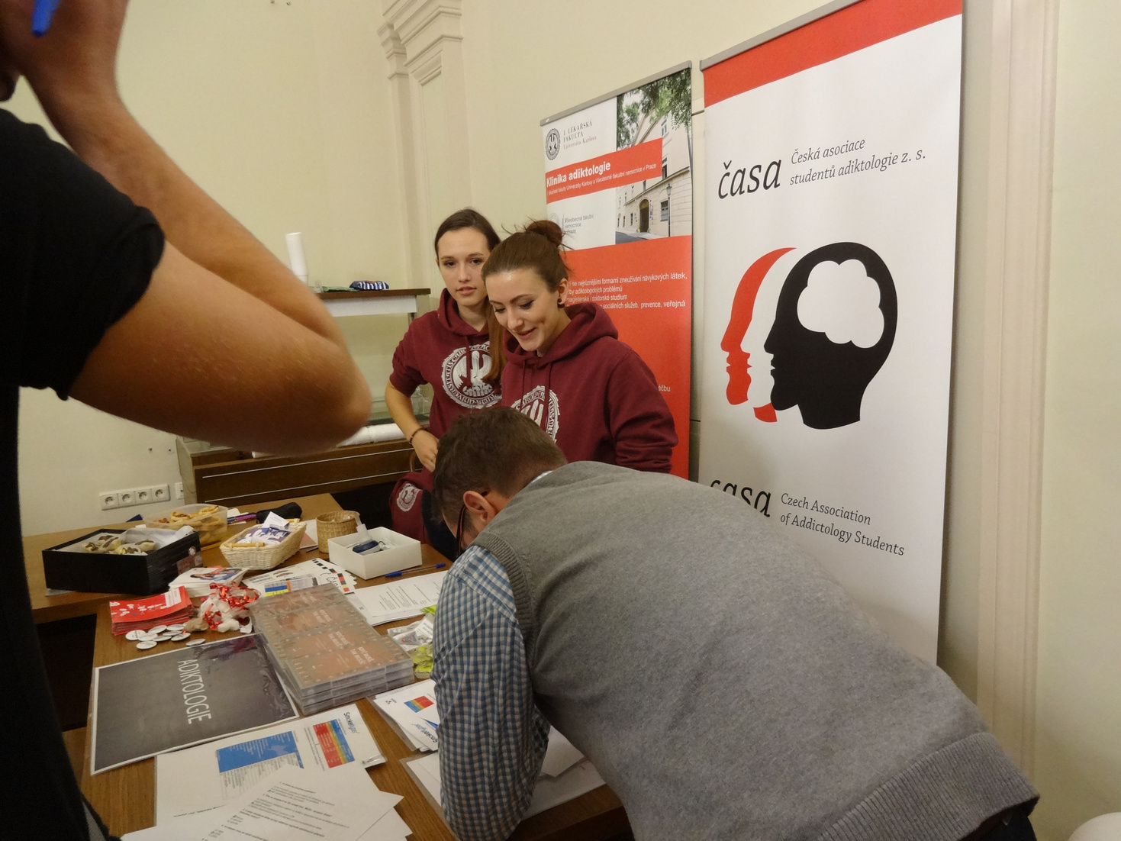
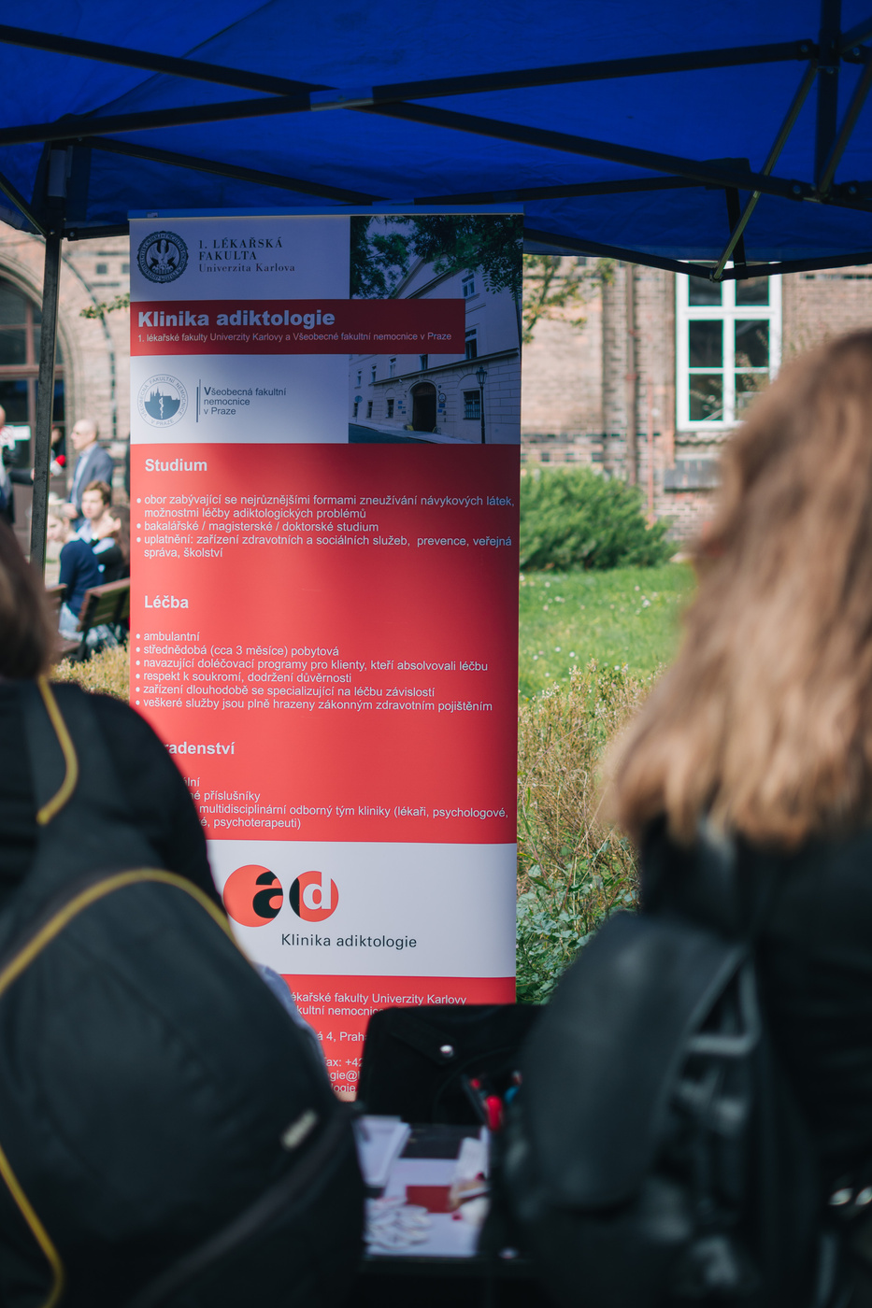
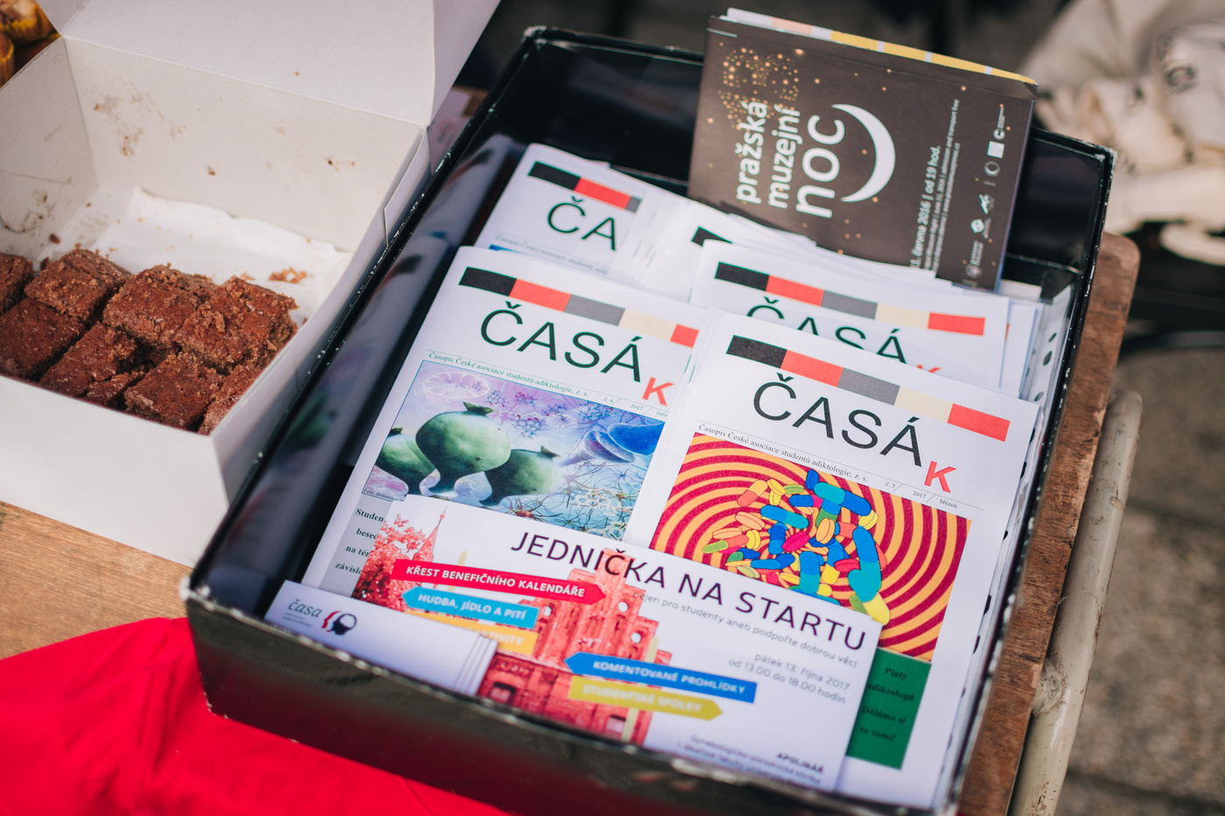
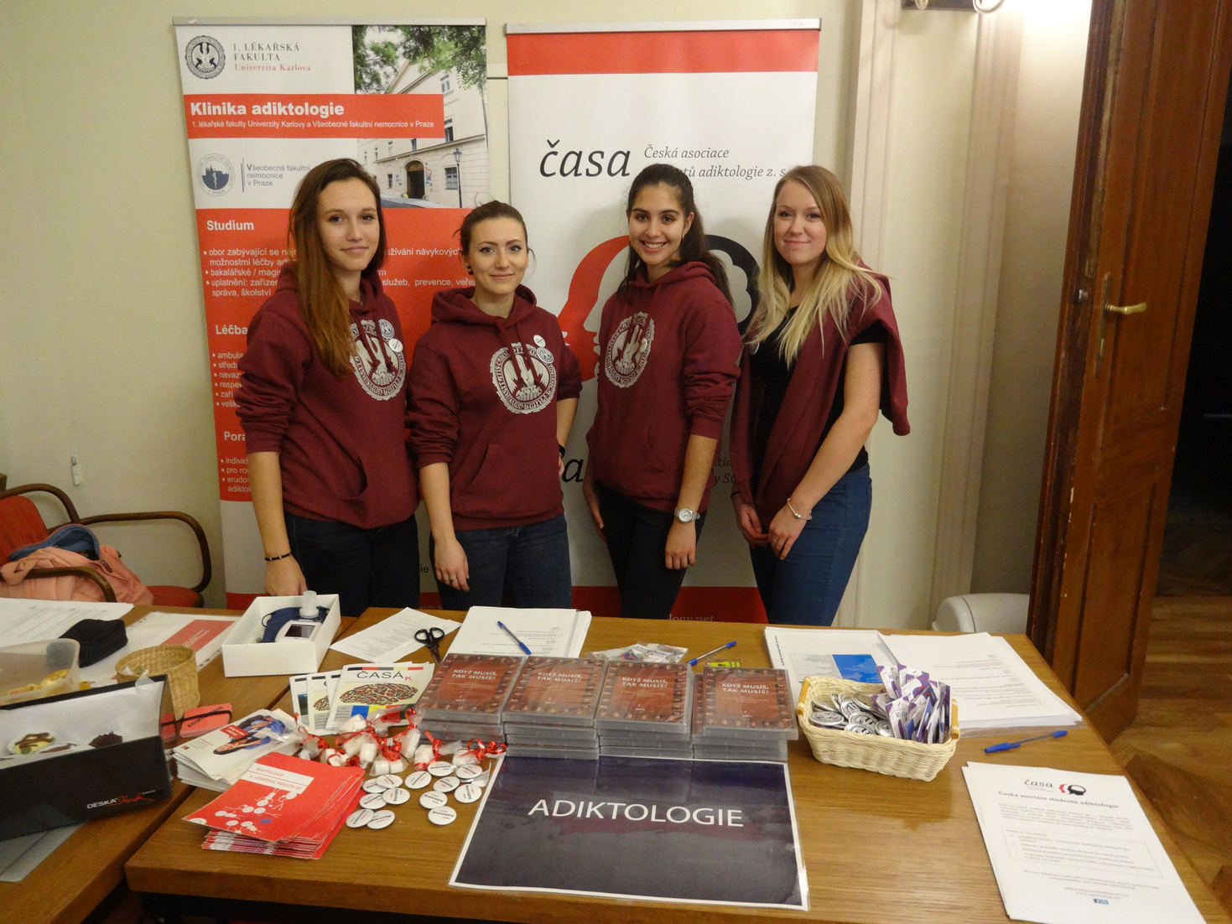
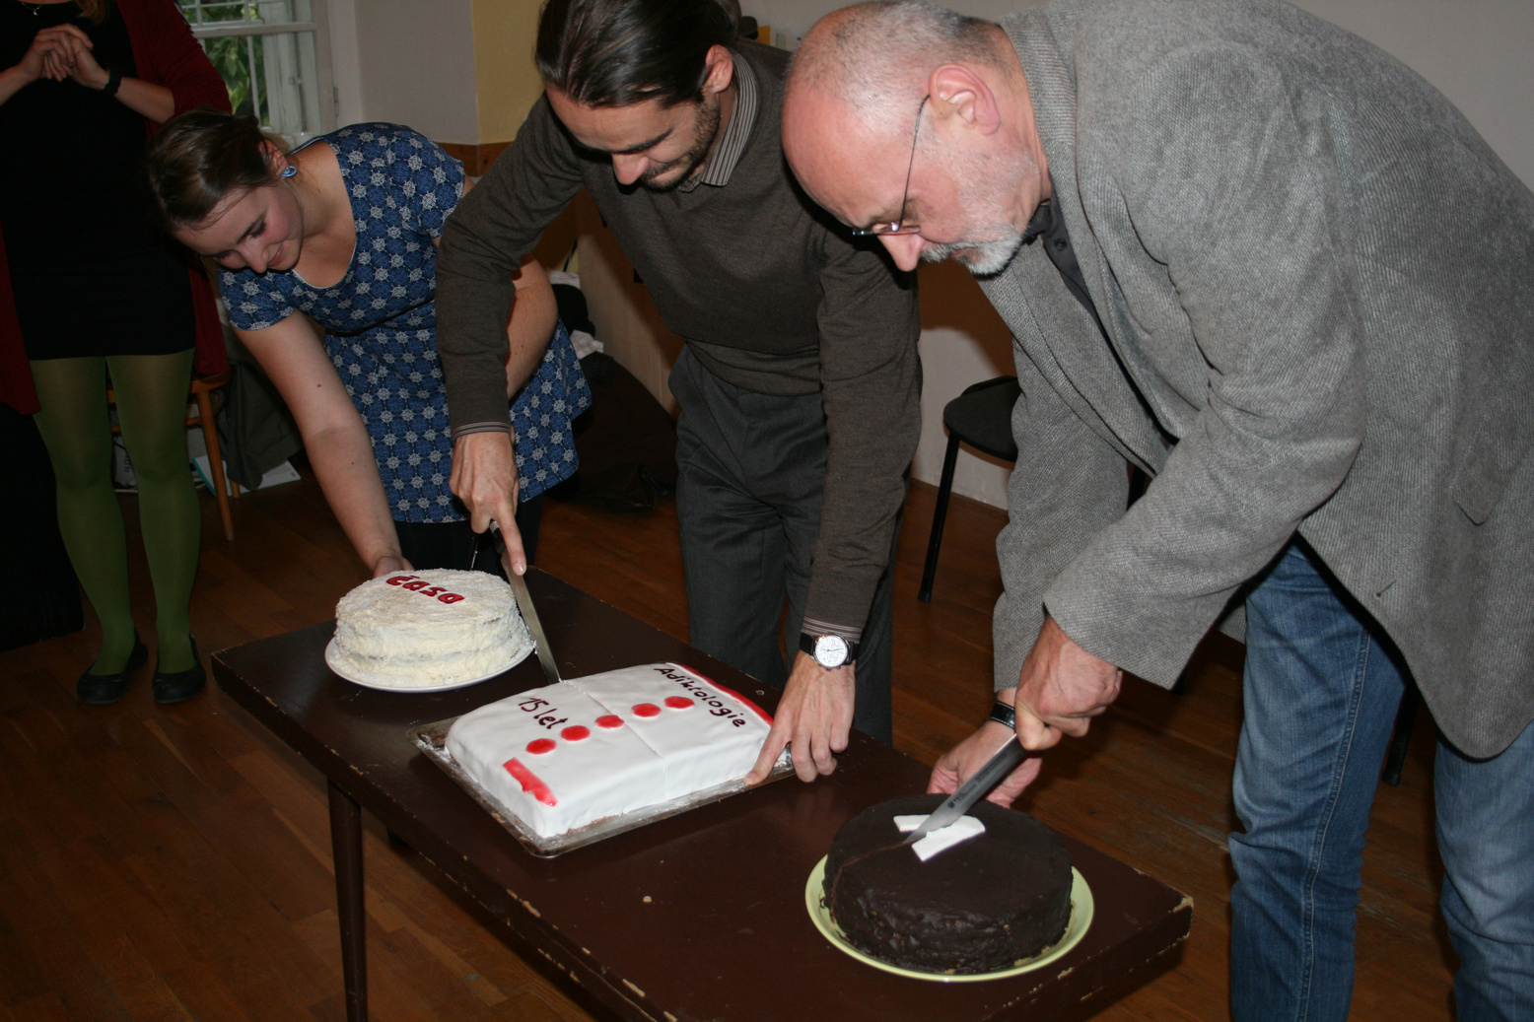
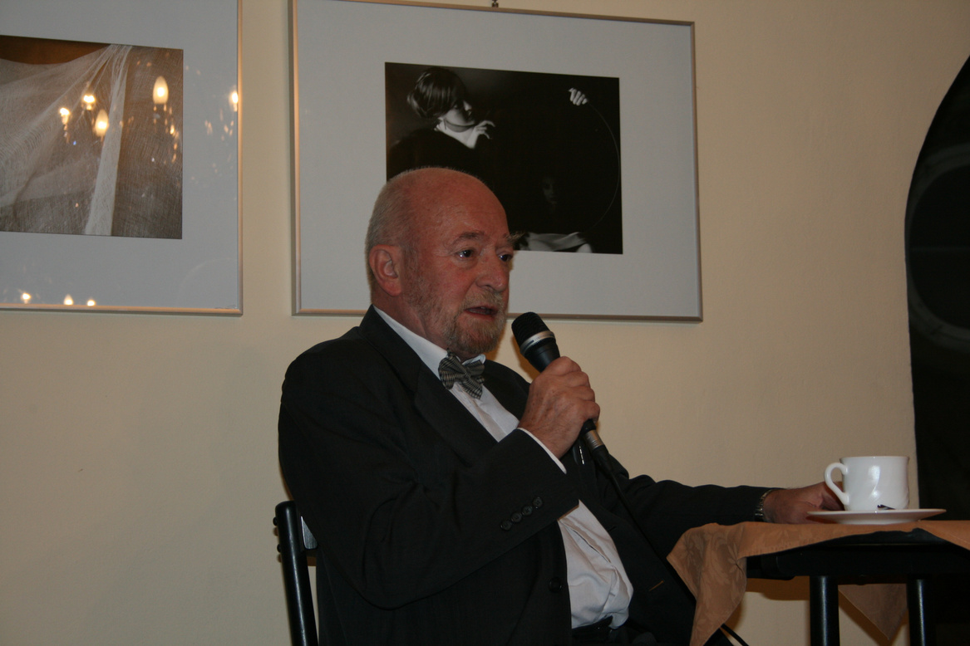

Slide 8
How students can work together to form a professional network?
How can teachers work together to support students in their progessional growth?

Slide 9
To sum up
01
YOU WILL ALWAYS FIND A FEW STUDENTS MOTIVATED TO DO BIG THINGS
What to keep in mind
Seek them!
02
YOU WILL ALWAYS FIND TEACHERS TO SUPPORT GOOD THINGS
It´s worth the time!
03
THE QUALITY OF THE FIELD GROWS WITH THE ACTIVITY OF STUDENTS
Go for it!

Slide 10
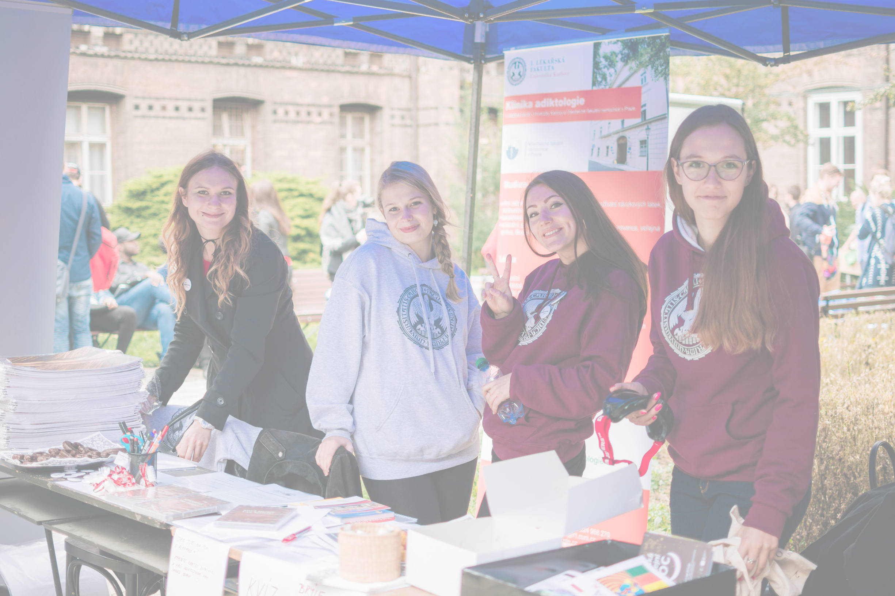
Thank you!
anna.volfova@lf1.cuni.cz
www.facebook.com/addictology.cz
www.addictology.net

